Slide 1

YouTube Text Data Analysis
Performed By : Ojas Shrivastava Full Stack Data Science Intern S.O. Infotech Private Limited

Slide 2
Problem Statement
1 Billion hours of YouTube content is watched per day. YouTube is the second most visited site in the world.
YouTube attracts about 44% of all internet users, 37% of internet traffic belongs to YouTube.
We have to find what is the exactly sentiment of the customers. Then, we have to analyze emoji and make the predictions and also find the audience engagement.
Analyze the trending videos of the YouTube data, and make conclusions of entire analysis.

Slide 3
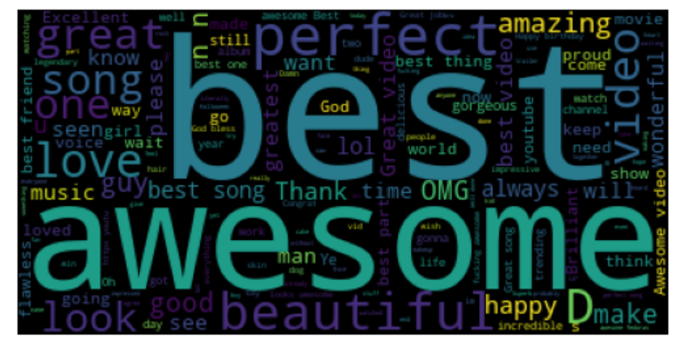
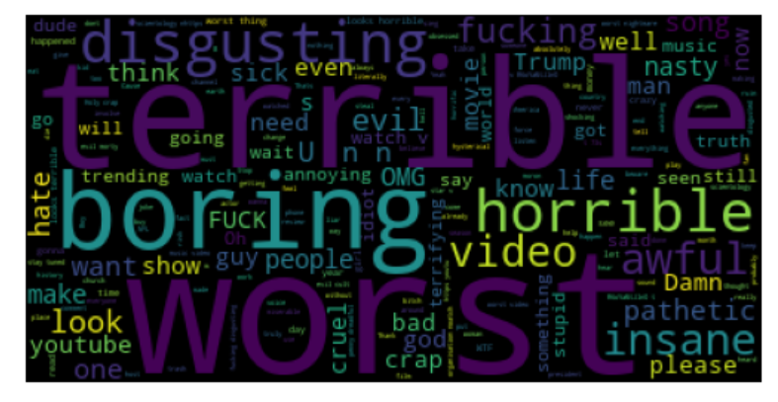
Sentimental Analysis: Sentimental analysis is the process of analyzing digital text to determine the emotional tone of message is positive, negative or neutral.
Conclusion :
- Positive users are emphasizing more on best, awesome, perfect, amazing, look, happy etc.
- Negative users are emphasizing more on terrible, worst, horrible, boring and disgusting.

Slide 4
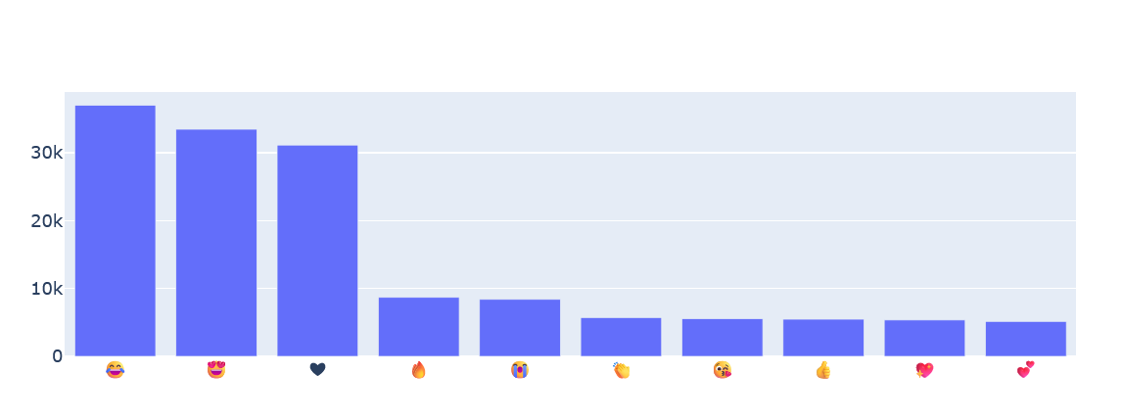
Emoji Analysis : It provides insight into digital communication visual language. From this we understand how customers reacts on YouTube videos in comment section.
Conclusion:
Majority of the customers are happy as most of them are using emojis like funny, love, and outstanding.

Slide 5
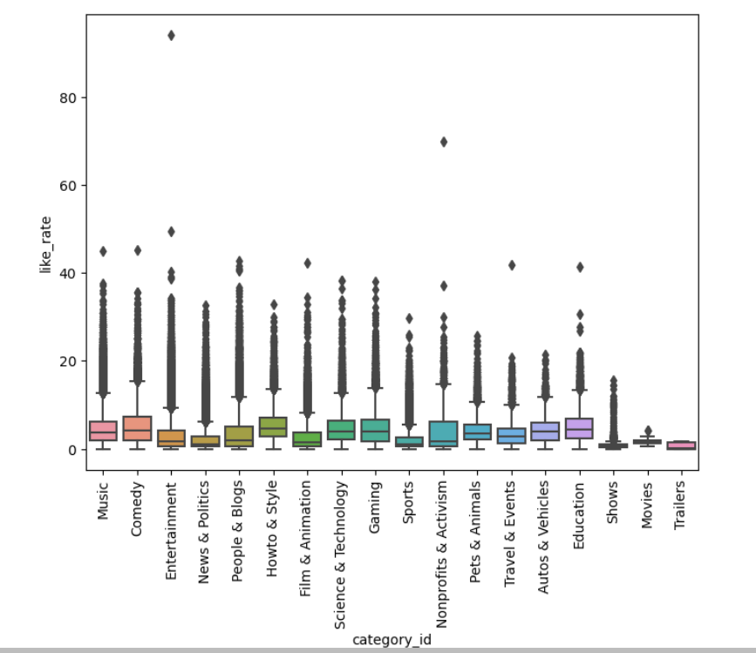
Audience Engagement: After analyzing all the data we produce a box plot image that clearly shows people and blogs performing well in like rate then music etc.
Conclusion:
In short music, comedy, entertainment, new and politics, people and blogs, film animation, science & technology and gaming are performing very well in audience engagement.

Slide 6
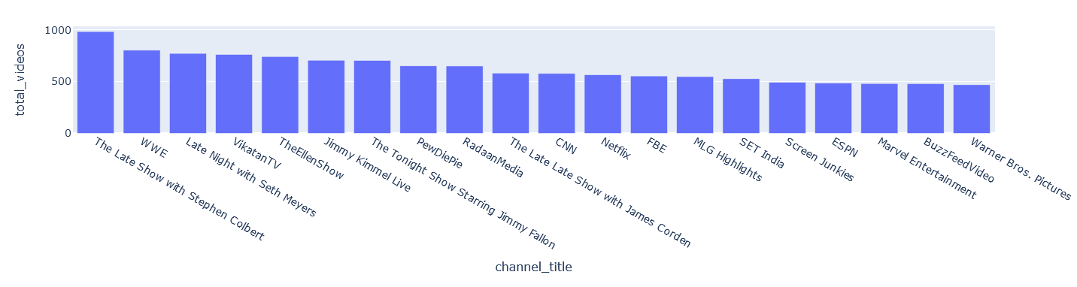
Trending Videos:
Conclusion: After analyzing all the data and data points we produce a bar graph in which here we clearly showed that The Late Show with Stephen Colbert is trending video in this YouTube data and Warner Bros. pictures is on last position.

